Slide 1

Face Recognition Bot
Presenter Names:
Uday Surisetty - VU21CSEN0600004
Aditya Ippili - VU21CSEN0600015
Ramcharan Aila - VU21CSEN0600067
Mohammad Sameer - VU21CSEN0600074
Guide Name:
Dr. Vikram Dhiman, Assistant Professor, CSE
CSE, GST, Visakhapatnam

Slide 2
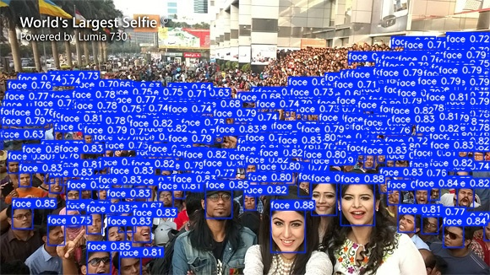
Contents
1. Abstract
2. Introduction
3. Literature Review
4. Requirement Analysis
5. Methodology
6. Conclusion
7. References
CSE, GST, Visakhapatnam

Slide 3
Abstract
Facial recognition technology plays a pivotal role in modern security, authentication, and surveillance systems, driving towards higher security and automation standards across various industries. This project compares two prominent models.
Haar-Cascade, a traditional machine learning approach, and YOLOv8, a state-of-the-art, open-source deep learning model and develops a facial detection and recognition system.
The system is designed to handle both single and multiple face detection and recognition tasks in static images, videos, and live video streams.
The project demonstrates how YOLOv8 excels in dynamic environments, handling multiple subjects and varying conditions such as lighting and occlusions more effectively than Haar Cascade.
In the future iterations, a face recognition bot is implemented, with plans to incorporate emotion detection, extending the system’s applications in security, human-computer interaction, and beyond.
CSE, GST, Visakhapatnam

Slide 4
Introduction
Rapidly advancing technology impacting multiple sectors.
Transforms organisational processes by:
Enhancing user experiences with seamless interactions.
Improving safety measures.
Automating identification processes to save time and reduce errors.
Rising demand for real-time solutions that deliver fast and accurate facial recognition.
Driven by developments in machine learning and deep learning, pushing the technology to new levels of performance.
This paper aims to evaluate and compare these two models—Haar Cascade and YOLOv8—in terms of their performance across several key criteria, including detection speed, accuracy, scalability, and robustness in handling environmental variables. The comparative analysis will involve single and multiple face detection and recognition tasks across different data sources, including static images, videos, and real-time video streams.
CSE, GST, Visakhapatnam

Slide 5
Literature Survey
S.No | Paper Title | Methodology | Advantages | Limitations | Research Gap
1 | YOLO: Unified, Real-Time Object Detection[1] | Single-stage detector combining classification and localization. Direct bounding box regression using convolutional layers. End-to-end model trained on the entire image. | Real-time speed suitable for video processing. Simplified architecture compared to multi-stage detectors. | Struggles with small object detection. Localization errors and lower accuracy compared to region-based methods. | Need for better localization accuracy and small object detection.
2 | YOLOv2: Better, Faster, Stronger[2] | Multi-scale training for robustness across resolutions. Introduction of anchor boxes and Darknet-19 backbone. Batch normalization for improved convergence. | Faster and more accurate than YOLOv1. Effective in balancing speed and accuracy. | Struggles with tiny objects and cluttered backgrounds. Limited improvements on certain dataset configurations. | Further refinement needed for small object localization and clutter handling.
CSE, GST, Visakhapatnam

Slide 6
S.No | Paper Title | Methodology | Advantages | Limitations | Research Gap
4 | Scaled-YOLOv4: Scaling Cross Stage Partial Network[4] | Scalable architecture with versions (tiny, standard, large) to accommodate different hardware capabilities. Better feature fusion and multi-scale detection. Continued use of advanced data augmentation and training techniques from YOLOv4. | Flexible scalability allows for deployment across a variety of devices from edge (tiny) to server-grade (large). Better performance across scales, making it adaptable for diverse use cases. Efficient training with advanced data augmentation techniques leading to faster convergence. | Complexity in choosing and configuring the right model version for specific use cases. Still not the best for small object detection in cluttered scenes. | Further research on optimizing model versions for different deployment environments (e.g., low-power devices). Improved accuracy for objects in densely cluttered or complex scenes
5 | YOLOv4: Optimal Speed and Accuracy of Object Detection[5] | Combined detection and classification tasks through a joint training approach using ImageNet and COCO datasets. Introduced WordTree, a hierarchical classification system that allows detection of over 9000 object categories. | Can detect over 9000 categories in real-time, significantly expanding object detection vocabulary. Maintains efficiency by using a hierarchical classification structure. Generalizes well, even for objects not seen during training. | Dependent on the scope of datasets used for training; accuracy may drop for unseen object variations. Localization of small or thin objects can still be challenging. | Further exploration of combining diverse datasets to improve classification and detection capabilities. Enhanced handling of multi-scale and small object detections, particularly in complex scenarios.
CSE, GST, Visakhapatnam

Slide 7
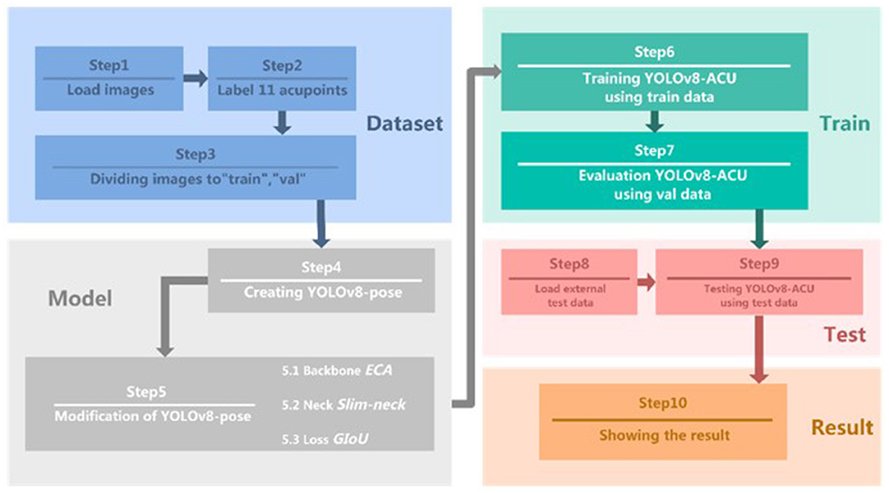
Objectives
Single Person Face Detection: The system should accurately detect a single face using YOLO and Haar Cascade models, with an evaluation of detection speed and accuracy.
Multiple Person Face Detection: The system should detect multiple faces in various orientations and positions, with a performance comparison between the two models.
Single Person Face Recognition: The system should recognize a specific individual from the detected face, matching it against a known dataset.
Multiple Person Face Recognition: The system should recognize multiple individuals in a frame, evaluating the recognition performance of YOLO model.
CSE, GST, Visakhapatnam

Slide 8
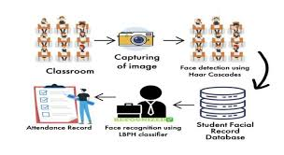
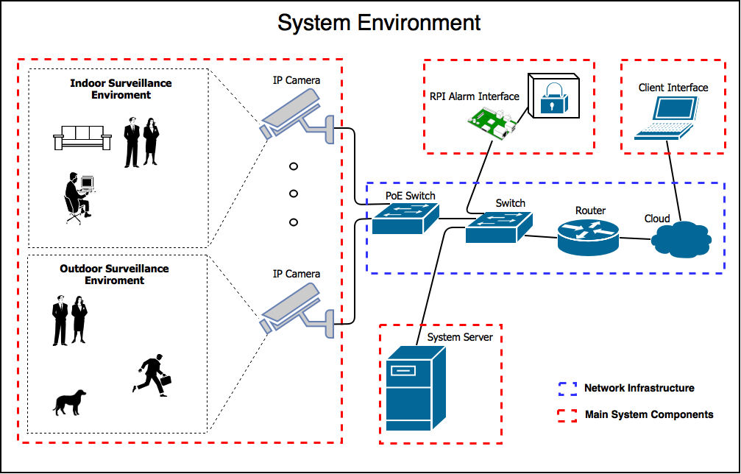
Applications
IoT-Based Data Logging & Reporting
The system can log face recognition data in an IoT database and generate real-time analytics for monitoring security breaches.
Dashboard integration with Power BI or Grafana can provide live statistics.
Emotion-Based Automated Responses
If the system detects emotions like stress or anger, it can trigger actions such as activating alarms or notifying security staff.
In smart homes, mood detection can be used to adjust lighting or music based on detected emotions.
Surveillance & Security Alerts
If an unknown face is detected, the system can send an alert notification to security personnel or a mobile app via MQTT or HTTP APIs.
Integrate with CCTV systems to monitor and record intrusions in real time.
CSE, GST, Visakhapatnam

Slide 9
Existing System
Haar Cascade Classifier
Haar Cascade is a classical computer vision technique for object detection. It's based on the Haar features, which are simple rectangular patterns used to detect specific features of an image.
Feature Extraction
The Haar features are extracted from the image. These features are patterns that can detect edges, lines, or regions of different brightness, such as the dark eyes against a lighter forehead.
Integral Image:
To make the calculation of Haar features faster, the algorithm uses an integral image. This data structure allows quick summation of pixel values within any rectangular subset of the image.
Cascade of Classifiers:
Instead of analyzing the entire image in one step, Haar Cascade uses a series of classifiers arranged in a cascade. Each classifier is trained to detect whether a region is likely to contain a face. If a region fails to pass a classifier, it is immediately discarded.
Sliding Window Approach:
The classifier scans the image using a sliding window of different sizes, detecting faces of varying scales. The windows move across the image, and the classifier checks each window to determine if it contains a face.
CSE, GST, Visakhapatnam

Slide 10
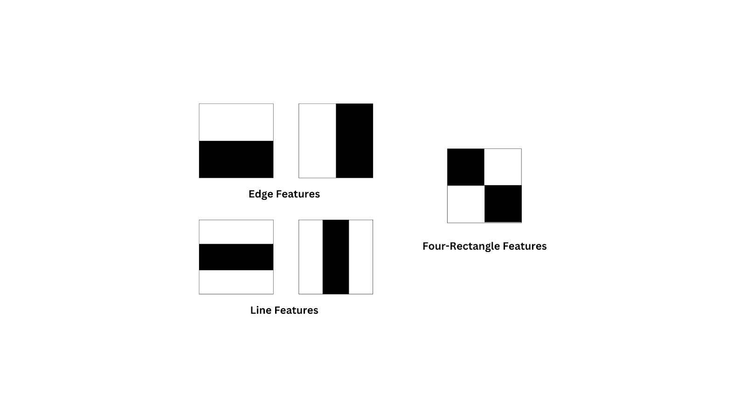
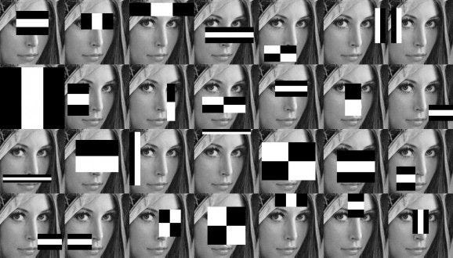
Existing System
Haar Cascade Classifier
CSE, GST, Visakhapatnam

Slide 11
Proposed System
YOLOv8 (You Only Look Once version 8)
YOLOv8 is a deep learning-based real-time object detection algorithm that treats the object detection task as a single regression problem. It predicts the bounding boxes and class probabilities directly from the entire image in one evaluation, making it very fast and suitable for real-time applications.
Convolutional Neural Network (CNN) Architecture: YOLOv8 uses a CNN to extract features from the input image. The network consists of convolutional layers, pooling layers, and fully connected layers to detect different features at different levels.
Grid-Based Detection: The image is divided into a grid of cells. Each cell predicts a set of bounding boxes and class probabilities for objects whose centers fall within the cell.
Bounding Box Prediction: Each bounding box is defined by four coordinates (x, y, width, height) and a confidence score indicating how likely the box contains an object. YOLOv8 also predicts class probabilities for the objects within the bounding boxes.
CSE, GST, Visakhapatnam

Slide 12
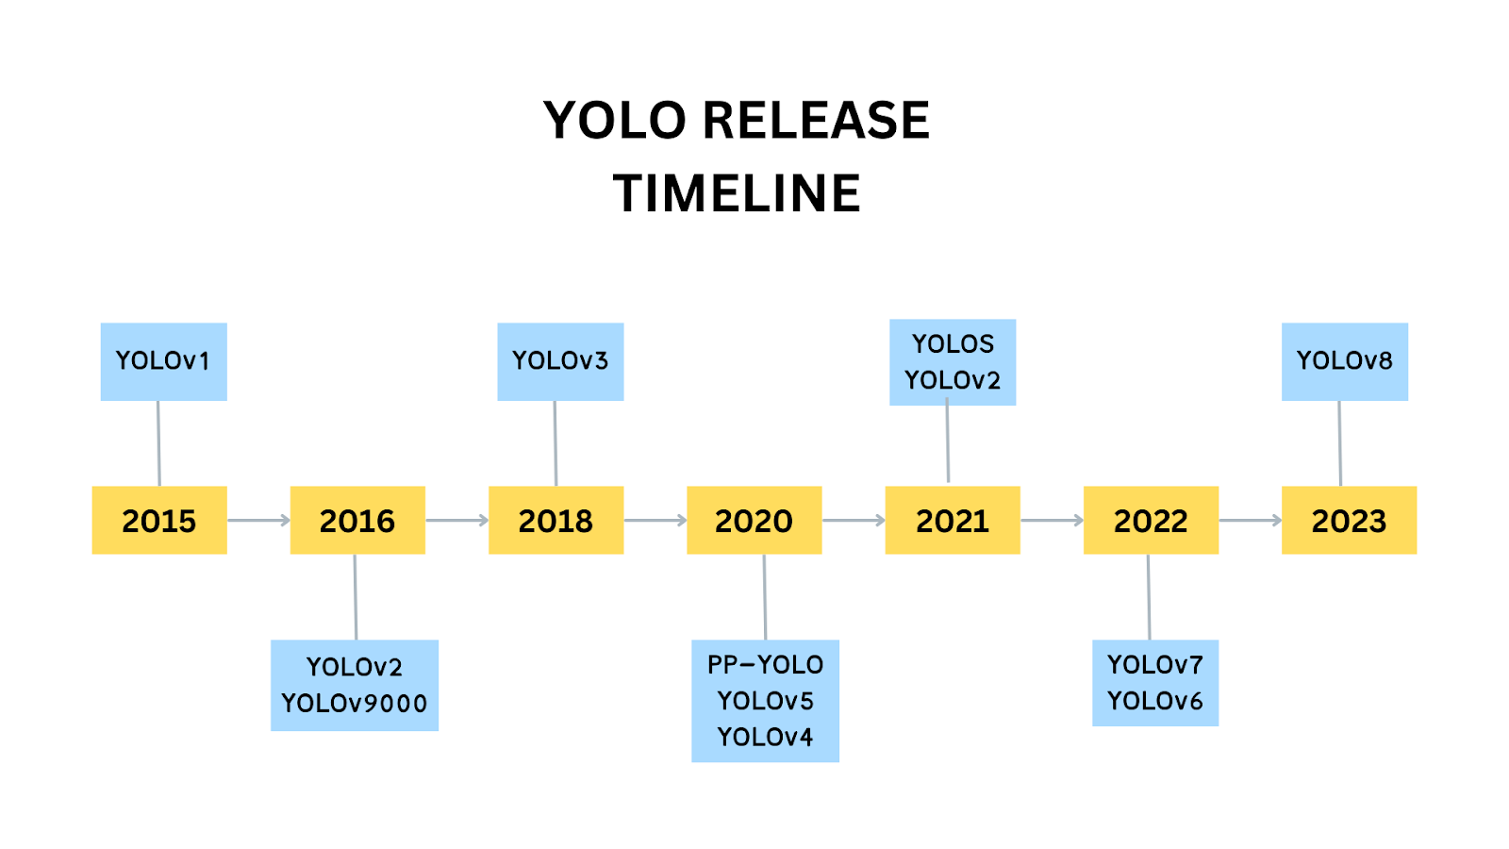
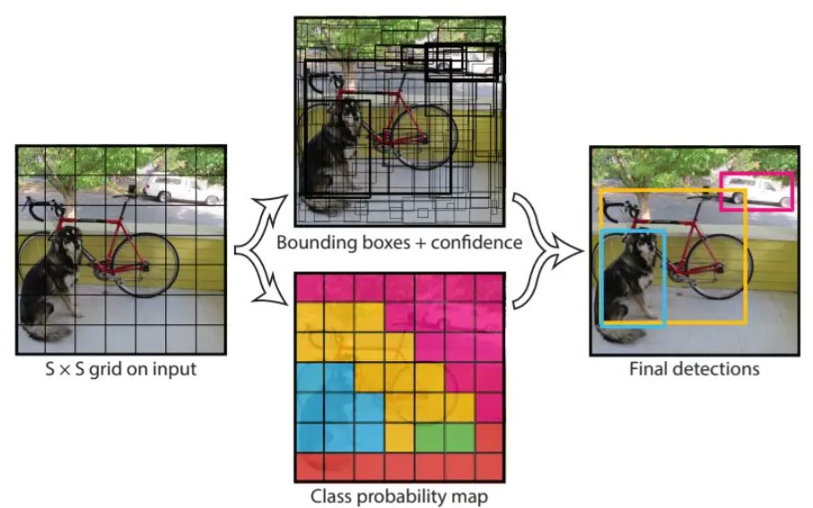
Anchor Boxes: The model uses predefined anchor boxes with various aspect ratios to predict bounding boxes more accurately.
Non-Maximum Suppression (NMS): To avoid multiple detections of the same object, YOLOv8 applies NMS to keep only the bounding box with the highest confidence score and remove others that overlap significantly.
Pre-trained weights and Transfer Learning: YOLOv8 can be fine-tuned using pre-trained weights (such as yolov8n-face.pt), which have been trained on large datasets. This allows for accurate face detection with minimal training time.
CSE, GST, Visakhapatnam

Slide 13
Requirement Analysis
The project aims to develop a real-time face detection and recognition system using Haar Cascade and YOLOv8 frameworks. The key requirements include:
Functional Requirements:
Detect and recognize faces in real-time from static images, video files, and live streams.
Identify multiple faces simultaneously.
Predict human emotions based on facial expressions.
Provide a user-friendly interface for interacting with the system.
Implement logging and access control mechanisms.
Non-Functional Requirements:
High-speed and efficient performance with minimal computational overhead.
Robust handling of different lighting conditions and occlusions.
Secure storage and retrieval of facial recognition data.
Scalability for integration with IoT devices.
CSE, GST, Visakhapatnam

Slide 14
System Analysis
System analysis involves understanding the requirements, functionalities, and constraints of the system. This phase will help to identify what the system needs to do, the components involved, and how they interact.
Input sources include images, video files, or live camera feeds.
Face detection module applies Haar Cascade and YOLOv8 models.
Recognition module matches detected faces with stored profiles.
Emotion detection module classifies expressions into predefined categories.
Database stores recognized faces and logs access details.
User interface enables easy interaction with the system.
Key Design Considerations:
Selection of deep learning vs traditional approaches based on performance trade-offs.
Use of GPU acceleration for real-time processing.
Incorporation of logging and alert mechanisms for security applications.
CSE, GST, Visakhapatnam

Slide 15
Tools
Programming Languages:
Python (for model implementation and GUI development)
Machine Learning Models:
YOLOv8 (for deep learning-based face detection)
Haar Cascade (for traditional rule-based detection)
Libraries & Frameworks:
OpenCV (for image processing)
Ultralytics YOLO (for YOLOv8 integration)
Tkinter (for GUI development)
NumPy (for data handling)
Databases:
SQLite / MySQL (for storing face recognition data and logs)
Development Tools:
Git & GitHub (for version control)
VS Code (for development & debugging)
Hardware & IoT:
Raspberry Pi / Arduino (for automation and access control)
Camera Modules (for live video input)
CSE, GST, Visakhapatnam

Slide 16
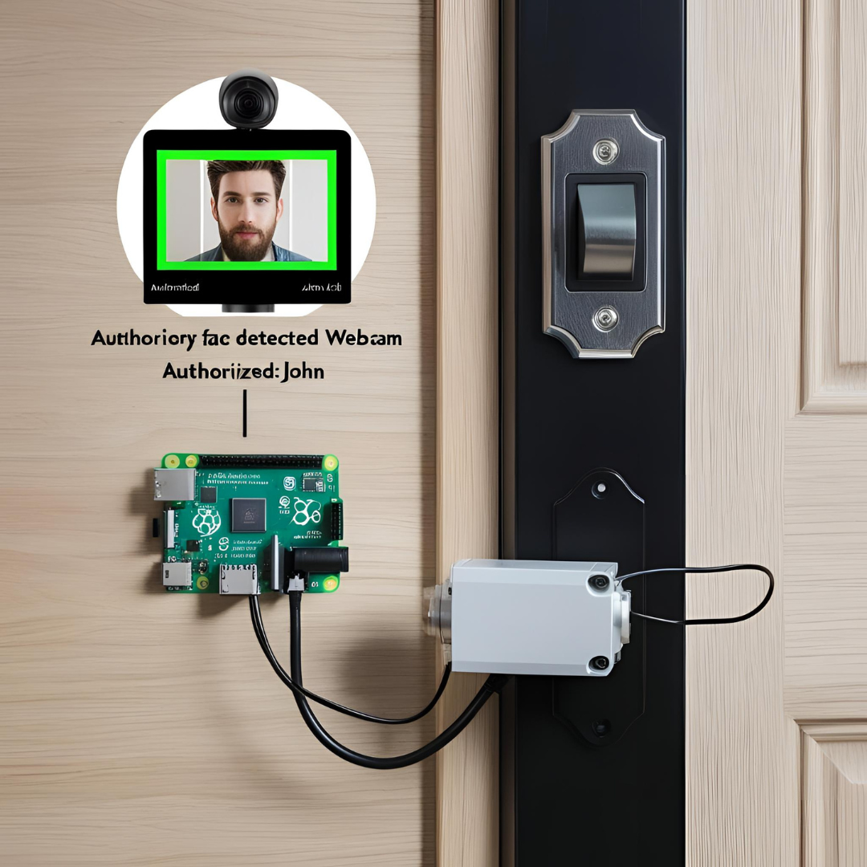
IOT Integration in Face Recognition
By integrating IoT with your face detection and recognition project, it transforms into a smart security and automation system. The project can be used for automated access control, real-time surveillance, attendance tracking, and smart home automation by connecting with IoT devices like Raspberry Pi, ESP8266, or cloud platforms (AWS IoT, Firebase, Azure IoT).
Use of the Project:
Enhanced Security – Automates access control with face authentication.
Smart Monitoring – Sends alerts for unknown faces in restricted areas.
Automated Attendance – Logs entries without manual intervention.
IoT-Based Automation – Controls doors, lights, and security systems.
CSE, GST, Visakhapatnam

Slide 17
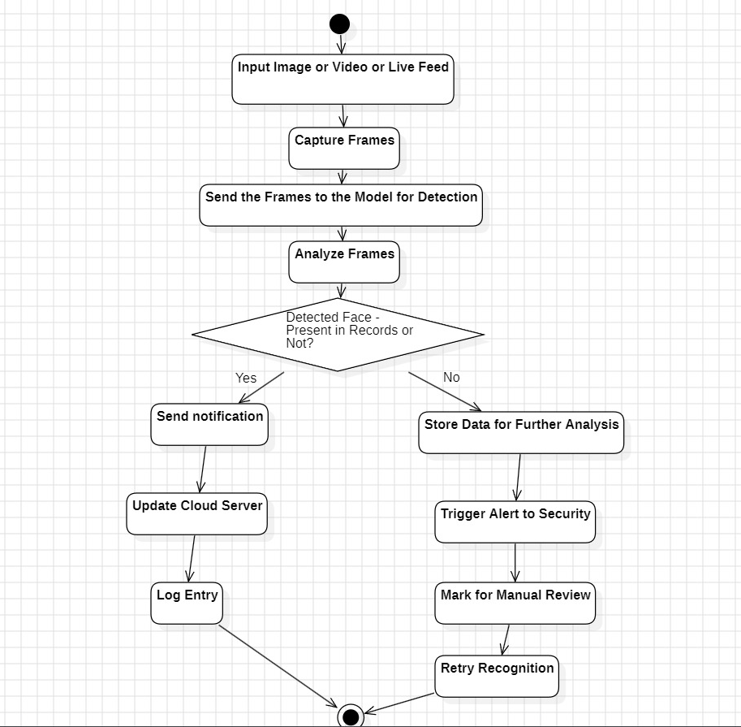
ACTIVITY DIAGRAM
Flow Start → Detect Motion → Capture Image → Analyze Image → Decision Point - Is Face Detected?If Yes: Continue to Recognize Face → Decision Point - Is Face Recognized?
If Yes:
Send Notification
Update Cloud Server
Log Entry
End
If No:
Store Data for Further Analysis
Trigger Alert to Security
Mark for Manual Review
Retry Recognition (Optional)
End
If No: Return to Detect Motion
CSE, GST, Visakhapatnam

Slide 18
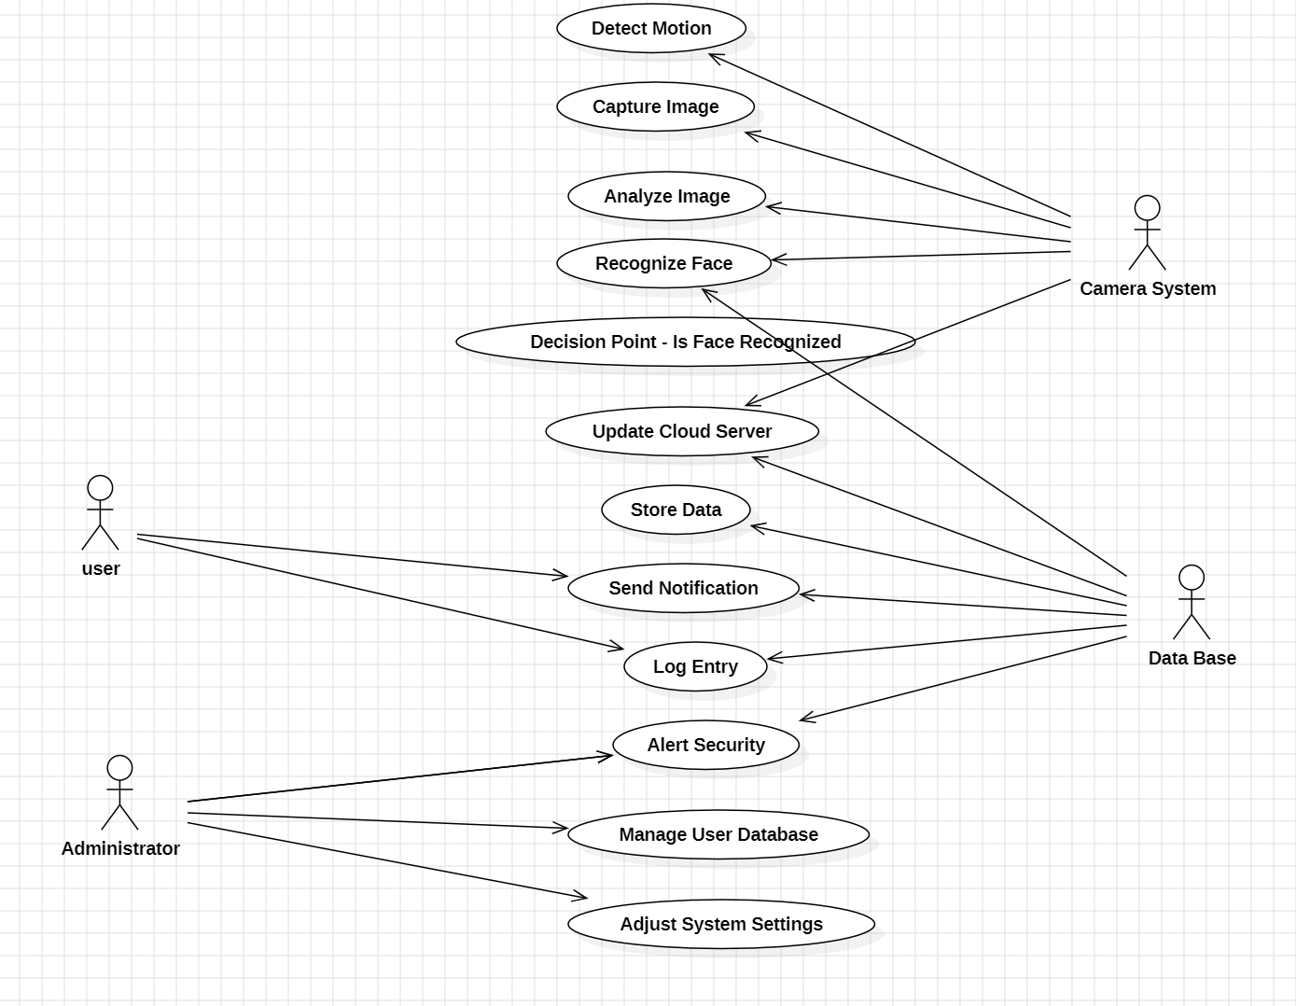
USECASE DIAGRAM
Actors and Components:
User: Receives notifications or alerts.
Camera System: Detects motion, captures images, and sends them for analysis.
Recognition Software: Processes images to detect and recognize faces.
Data Base: Stores data, manages logs, and sends notifications or alerts.
Administrator: Manages system settings, reviews unrecognized images, and updates the database.
CSE, GST, Visakhapatnam

Slide 19
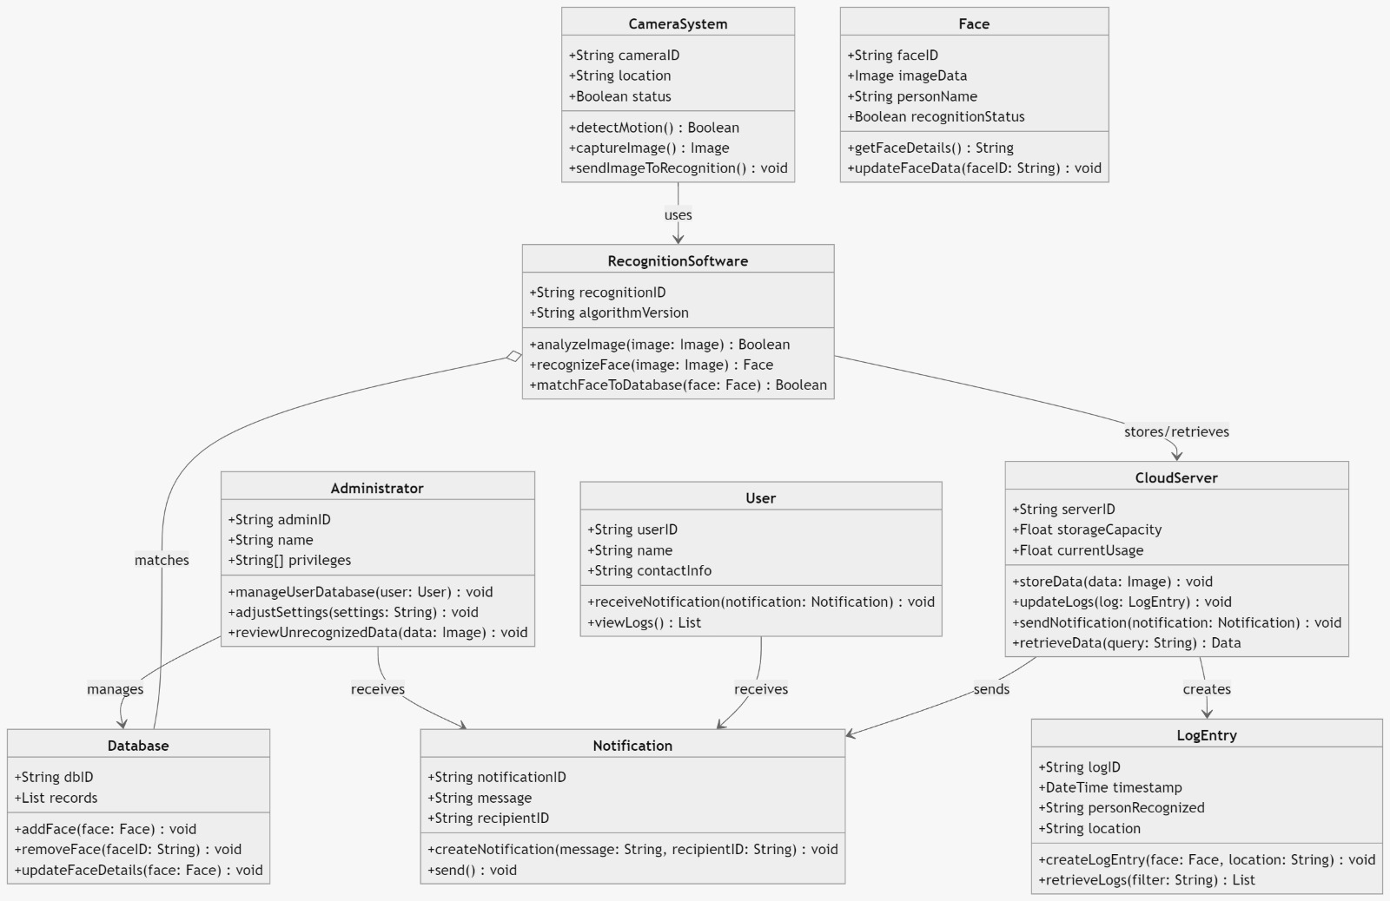
CLASS DIAGRAM
Relationships:
CameraSystem "uses" RecognitionSoftware for analyzing and recognizing faces (analyzeImage, recognizeFace).
RecognitionSoftware has an "association" with Database to match detected faces.
RecognitionSoftware interacts with CloudServer to store and retrieve data.
CloudServer "sends" Notification to User and Administrator.
User and Administrator "receive" notifications and have access to LogEntry records.
Administrator has a "control" relationship with Database for managing user data (e.g., adding or removing faces).
LogEntry objects are created by CloudServer when a face is recognized or unrecognized.
CSE, GST, Visakhapatnam

Slide 20
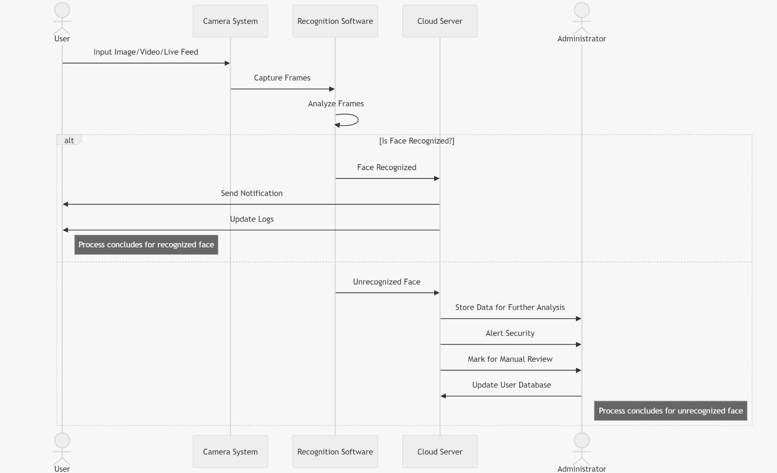
SEQUENCE DIAGRAM
Diagram Structure:
Actors (Top):
User (on the left): Receives notifications and alerts.
Camera System: Detects motion, captures images.
Recognition Software: Analyzes and matches faces.
Cloud Server: Manages data storage and sends alerts.
Administrator (on the right): Reviews unrecognized entries and manages the system.
CSE, GST, Visakhapatnam

Slide 21
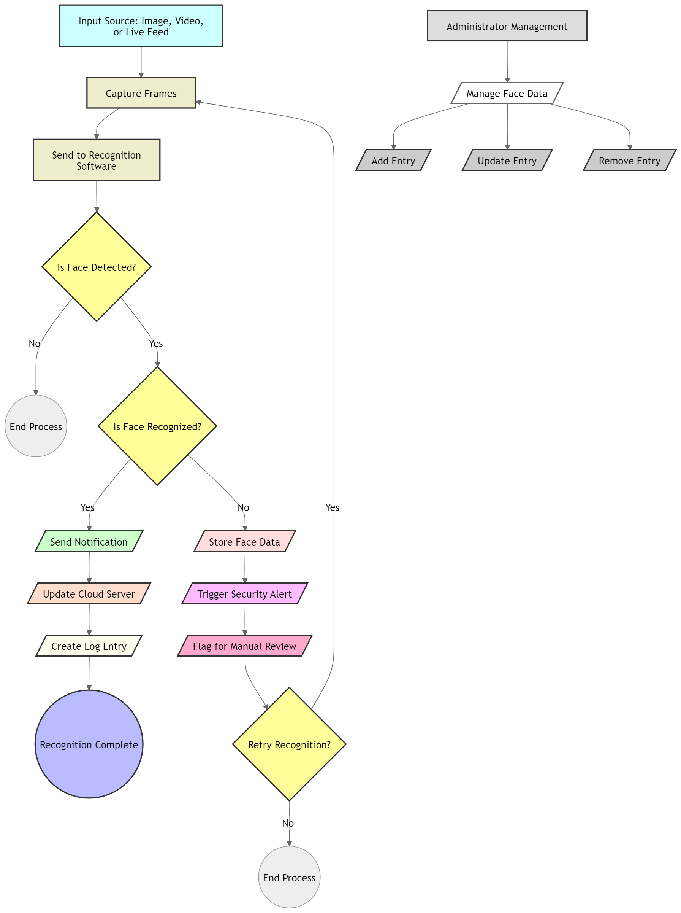
DATA FLOW
Data Flow Between Components:
Camera System sends images to Recognition Software.
Recognition Software analyzes the image and communicates with the Cloud Server.
Cloud Server logs the event, updates the database, and sends appropriate notifications.
User Interface allows users to interact with the system, view logs, and manage settings.
CSE, GST, Visakhapatnam

Slide 22
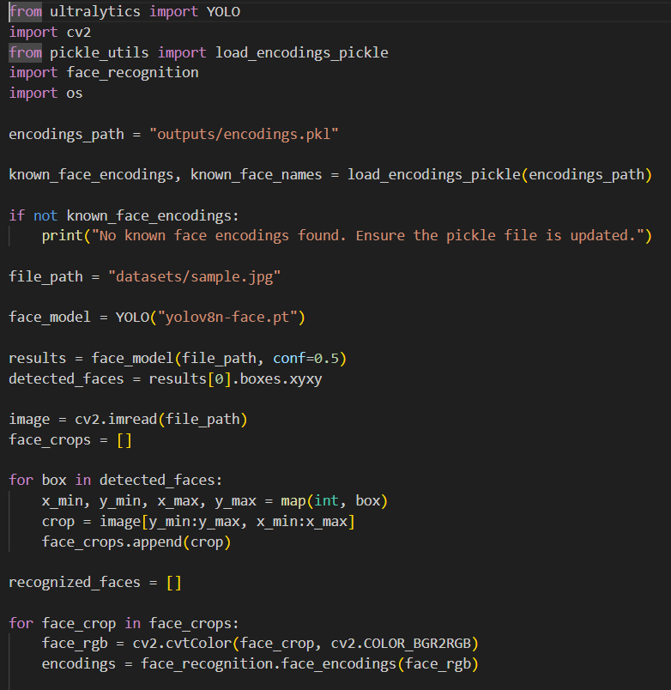
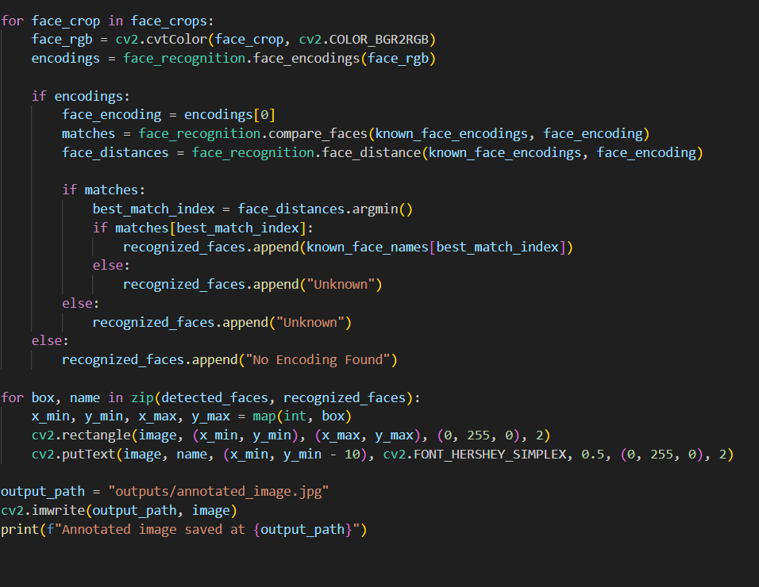
Implementation
Code for static images and videos
CSE, GST, Visakhapatnam

Slide 23
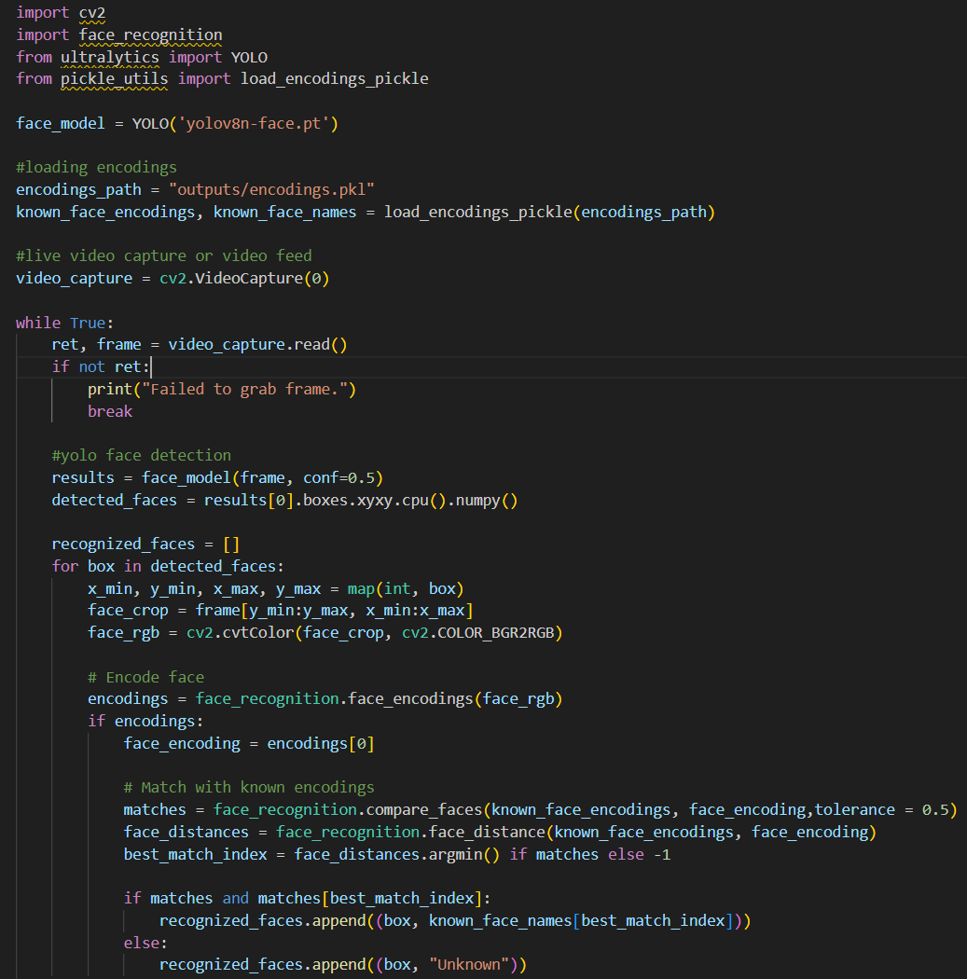
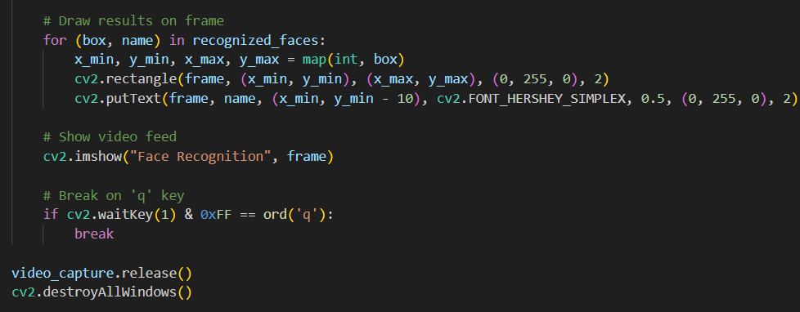
Implementation
CSE, GST, Visakhapatnam

Slide 24
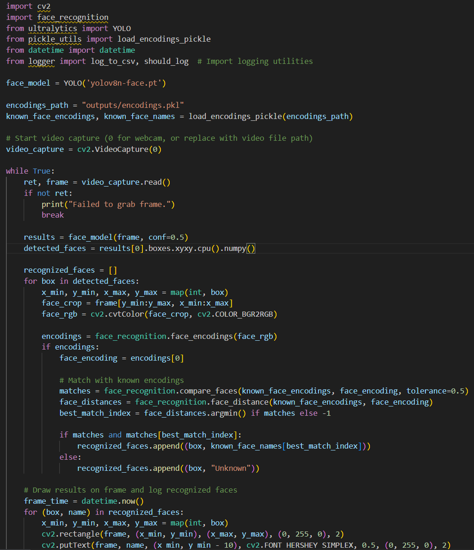
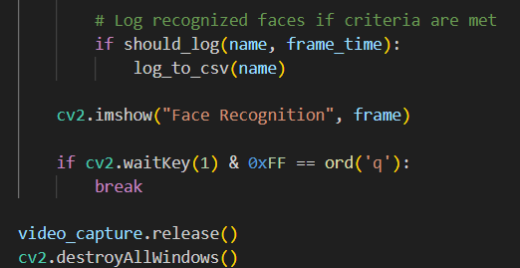
Implementation
CSE, GST, Visakhapatnam

Slide 25
Result
Performance Comparison
YOLOv8 achieved an accuracy of ~96% in controlled environments, while Haar Cascade reached ~75%.
YOLOv8 maintained ~92% accuracy under varied conditions, whereas Haar Cascade dropped to ~60%.
Processing speed: YOLOv8 on GPU achieved 35-40 FPS, while Haar Cascade on CPU managed ~20-30 FPS.
Key Observations:
YOLOv8 performed well under complex environments and occlusions.
Haar Cascade was computationally lighter but struggled with multi-face detection and low-light scenarios.
Real-time emotion detection enhanced the security application of the system.
CSE, GST, Visakhapatnam

Slide 26
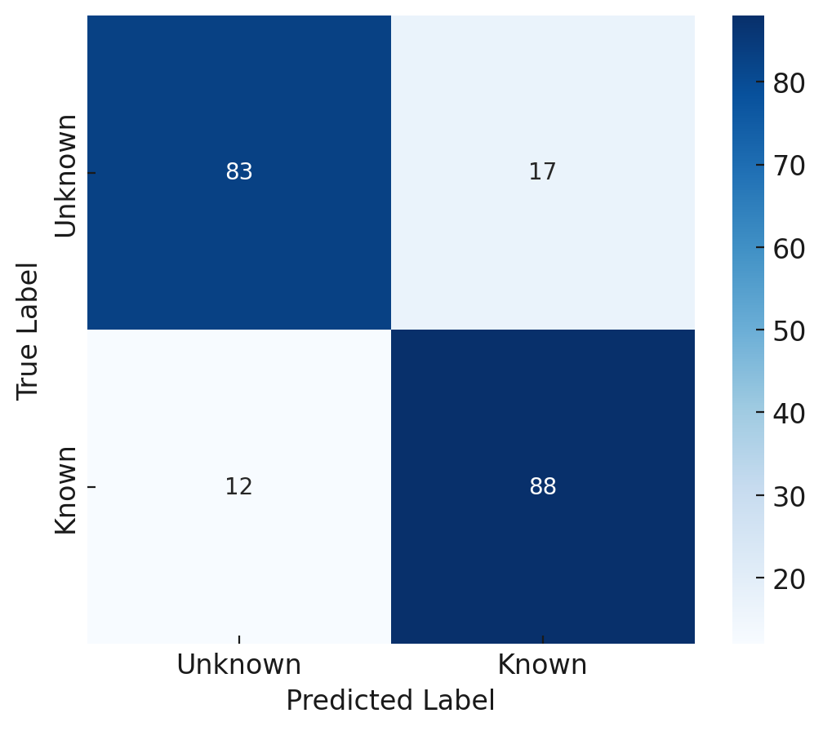
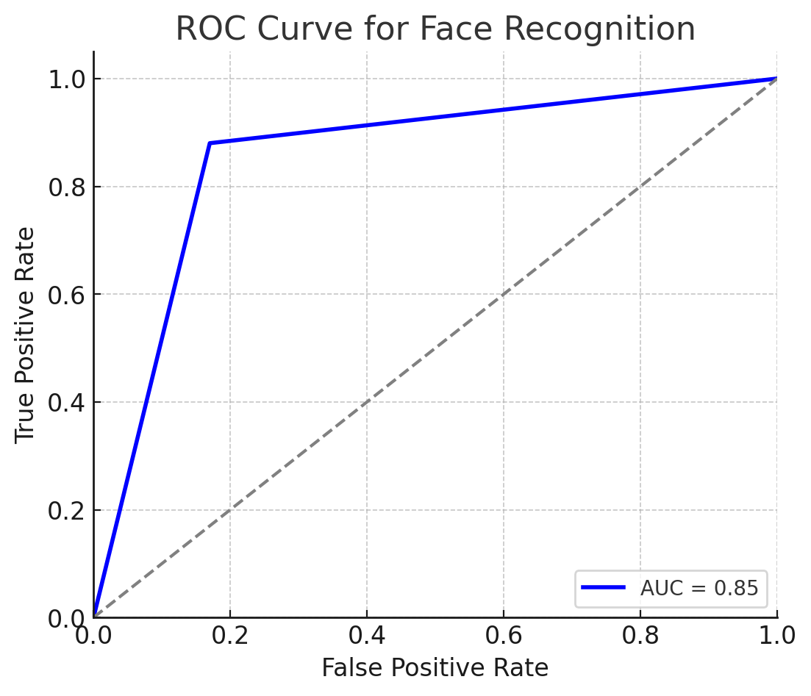
Performance Outcome
The ROC (Receiver Operating Characteristic) curve evaluates model performance at different threshold levels by plotting True Positive Rate (TPR) against False Positive Rate (FPR). A higher Area Under the Curve (AUC) indicates better classification accuracy.
The prediction table (confusion matrix) provides metrics like True Positives (TP), False Positives (FP), True Negatives (TN), and False Negatives (FN). It helps analyze model misclassifications and fine-tune thresholds.
CSE, GST, Visakhapatnam

Slide 27
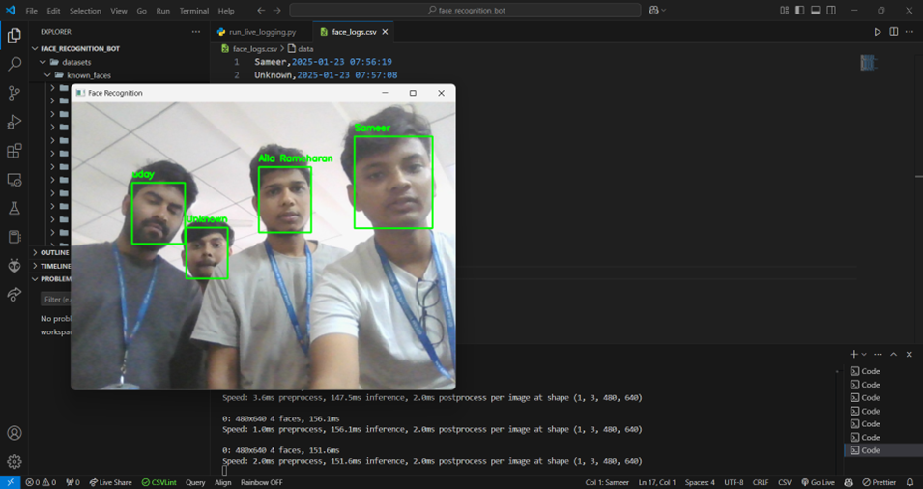
Screenshots of the project
CSE, GST, Visakhapatnam

Slide 28
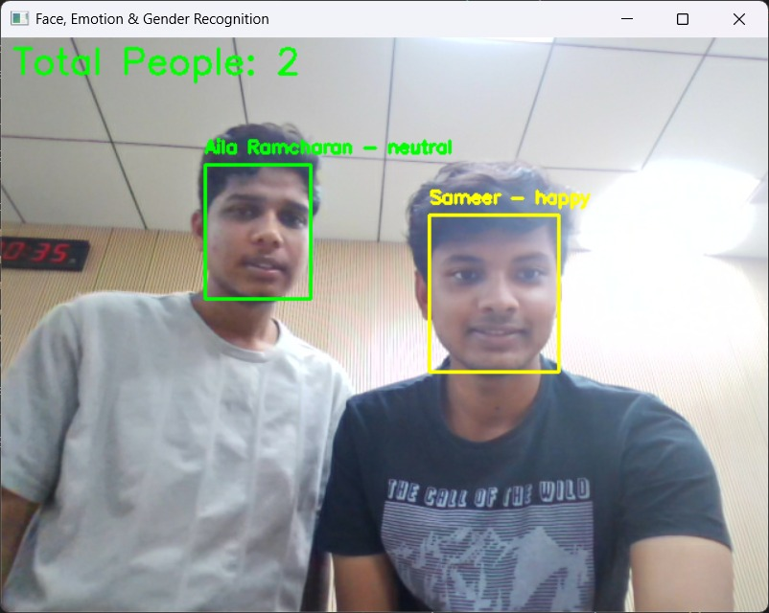
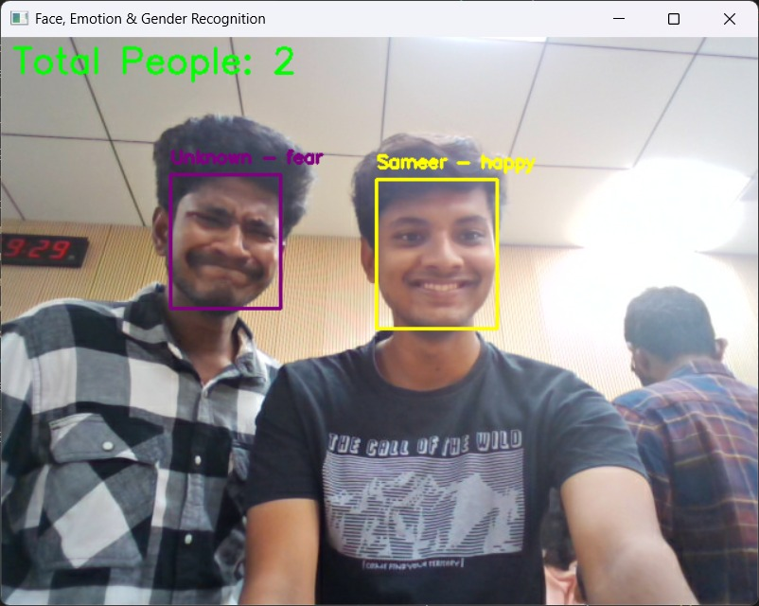
Screenshots of the project
CSE, GST, Visakhapatnam

Slide 29
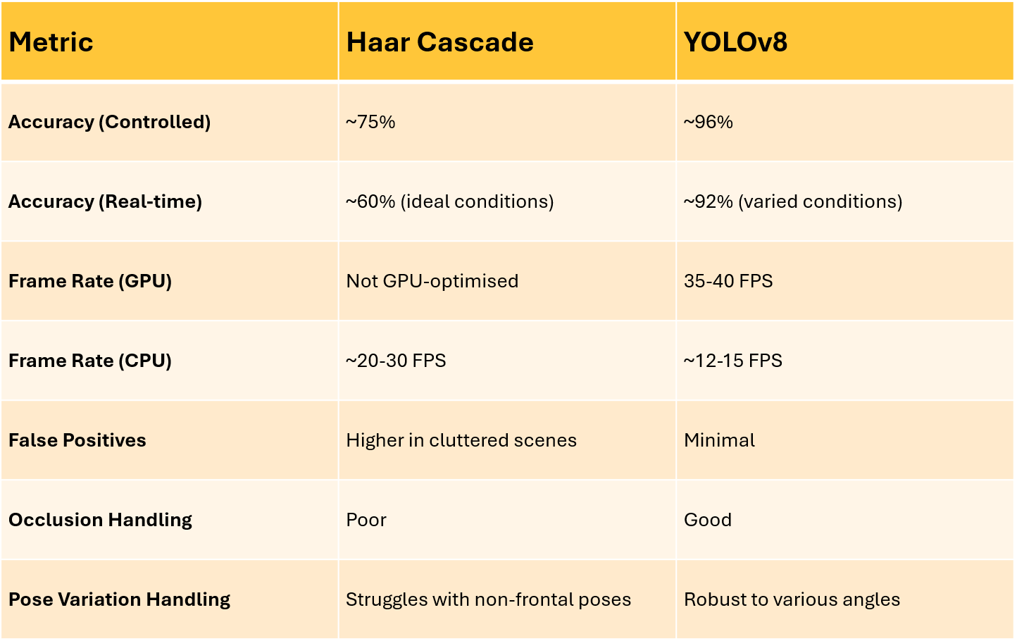
CSE, GST, Visakhapatnam

Slide 30
Conclusion
The project successfully implemented real-time face detection and recognition using both Haar Cascade and YOLOv8.
YOLOv8 outperformed Haar Cascade in terms of accuracy, robustness, and real-time performance.
The system effectively integrated emotion detection and access control features.
Future Work
Improve recognition accuracy by integrating attention mechanisms.
Optimize YOLOv8 for edge devices with low computational power.
Expand the system to support gesture recognition for enhanced security applications.
Develop an advanced alert mechanism using AI-based anomaly detection.
CSE, GST, Visakhapatnam

Slide 31
References
[1] Redmon, Joseph & Divvala, Santosh & Girshick, Ross & Farhadi, Ali. (2016). You Only Look Once: Unified, Real-Time Object Detection. 779-788. 10.1109/CVPR.2016.91.
[2] Huang, Xin & Wang, Xinxin & Lv, Wenyu & Bai, Xiaying & Long, Xiang & Deng, Kaipeng & Dang, Qingqing & Han, Shumin & Liu, Qiwen & Hu, Xiaoguang & Yu, Dianhai & Ma, Yanjun & Yoshie, Osamu. (2021). PP-YOLOv2: A Practical Object Detector. 10.48550/arXiv.2104.10419.
[3] Redmon, Joseph, and Farhadi, Ali. "YOLOv3: An Incremental Improvement." arXiv preprint arXiv:1804.02767 (2018).
[4] C. -Y. Wang, A. Bochkovskiy and H. -Y. M. Liao, "Scaled-YOLOv4: Scaling Cross Stage Partial Network," 2021 IEEE/CVF Conference on Computer Vision and Pattern Recognition (CVPR), Nashville, TN, USA, 2021, pp. 13024-13033, doi: 10.1109/CVPR46437.2021.01283.
[5] Bochkovskiy, Alexey & Wang, Chien-Yao & Liao, Hong-yuan. (2020). YOLOv4: Optimal Speed and Accuracy of Object Detection. 10.48550/arXiv.2004.10934.
[6] J. Nishimura and T. Kuroda, "Versatile Recognition Using Haar-Like Feature and Cascaded Classifier," in IEEE Sensors Journal, vol. 10, no. 5, pp. 942-951, May 2010, doi: 10.1109/JSEN.2009.2038231.
[7] H. Aung, A. V. Bobkov and N. L. Tun, "Face Detection in Real Time Live Video Using Yolo Algorithm Based on Vgg16 Convolutional Neural Network," 2021 International Conference on Industrial Engineering, Applications and Manufacturing (ICIEAM), Sochi, Russia, 2021, pp. 697-702, doi: 10.1109/ICIEAM51226.2021.9446291
CSE, GST, Visakhapatnam

Slide 32
Thank You
CSE, GST, Visakhapatnam

